Slide 1

UDP, Complete compare, and Generating Reports
By: Group 3

Slide 2
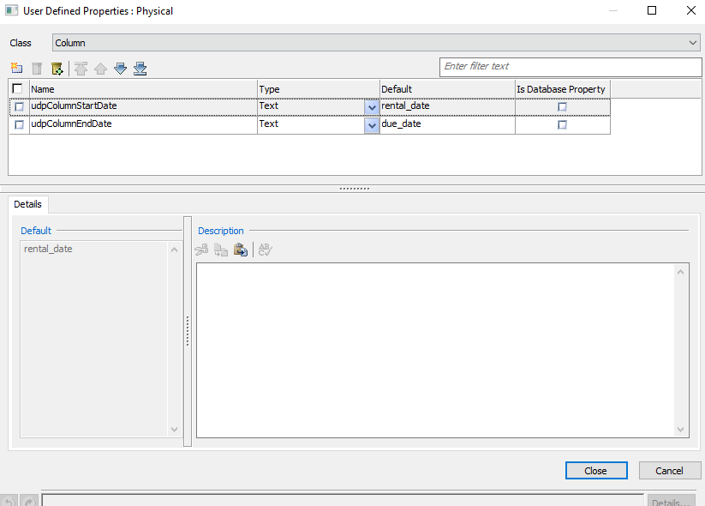
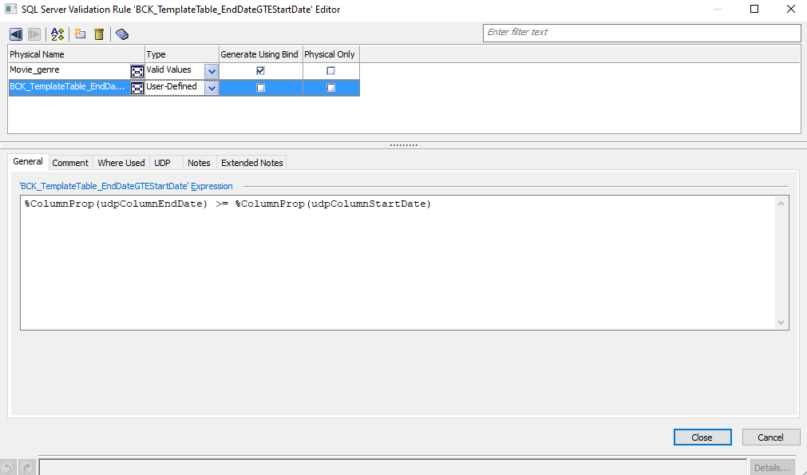
UDP Creation, validation creation
Notes:
eMovies model by default does not include any UDPs so we created 2 and added our own, one called udpColumnStartDate, and the other calling udpColumnEndDate. After creating the udp we applied it to the Validation rule called EndDateGTEDate, with udpColumnEndDate being greater than or equal to SudpColumnStartDate ensuring that in our context of eMovies, the due_date will come after the rental_date.

Slide 3
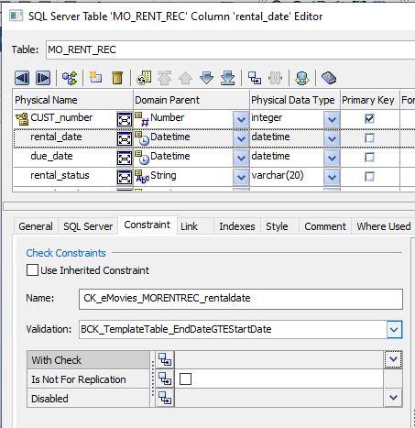
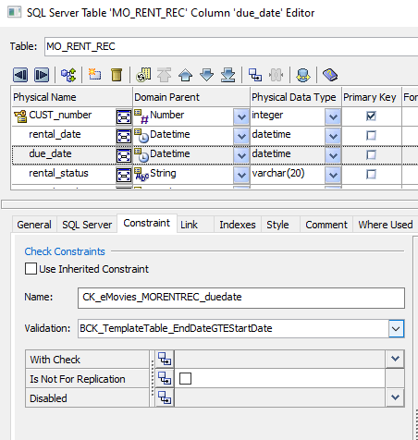
Applying UDP to Validations
Notes:
Applying validations to both rental_date column and due_date column under MO_RENT_REC allows us to ensure that rental_date always comes before the due_date and vise versa.

Slide 4
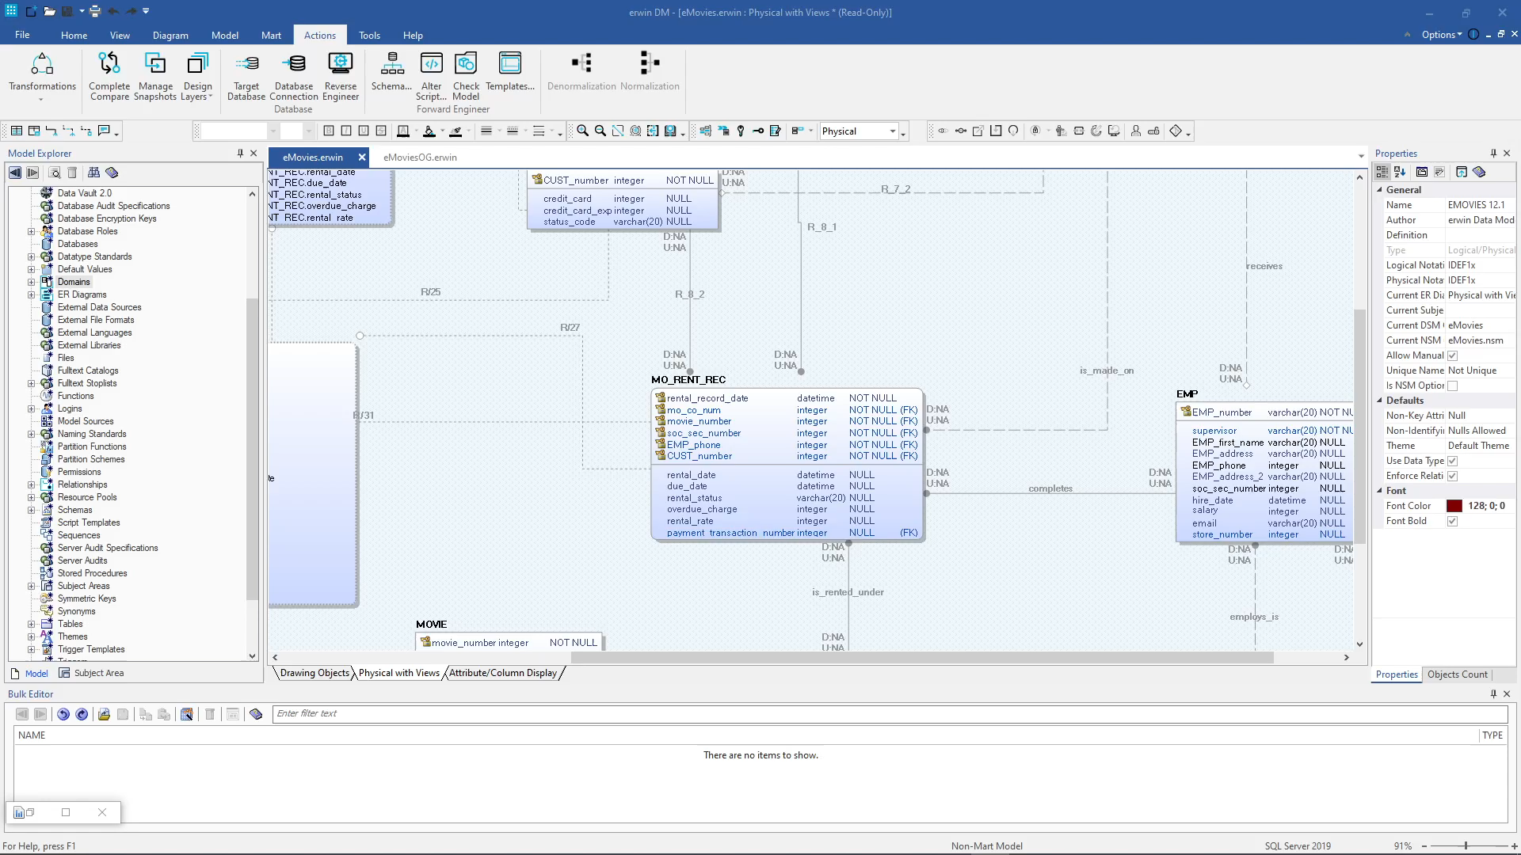
Complete Compare

Slide 5
Generating reports

